Slide 1
To Unify Space and Time in Action Selection PART 1: A Stochastic and Spatially Unhomogenous Threshold to Unify Micro and Macro-saccades
Geoffrey Mégardon
2017

Slide 2
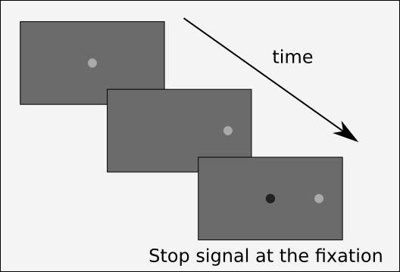
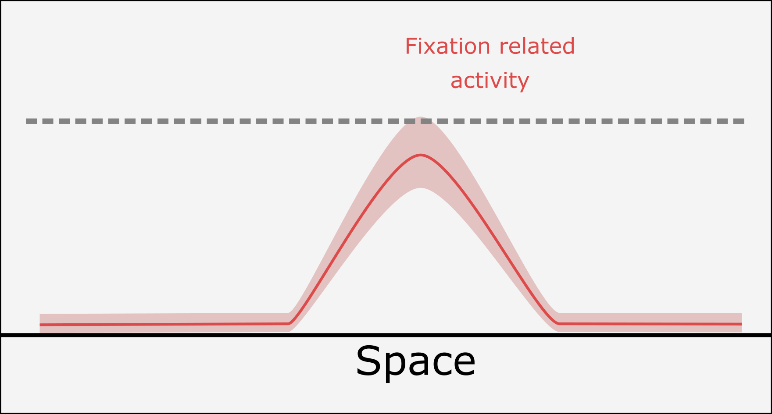
INTRODUCTION
DINASAUR and Annie’s experiment

Slide 3
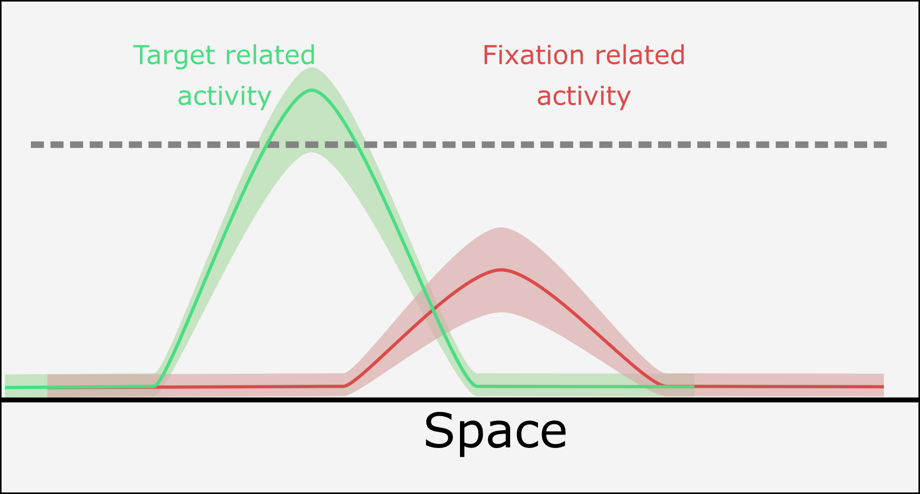
INTRODUCTION
DINASAUR and Annie’s experiment

Slide 4
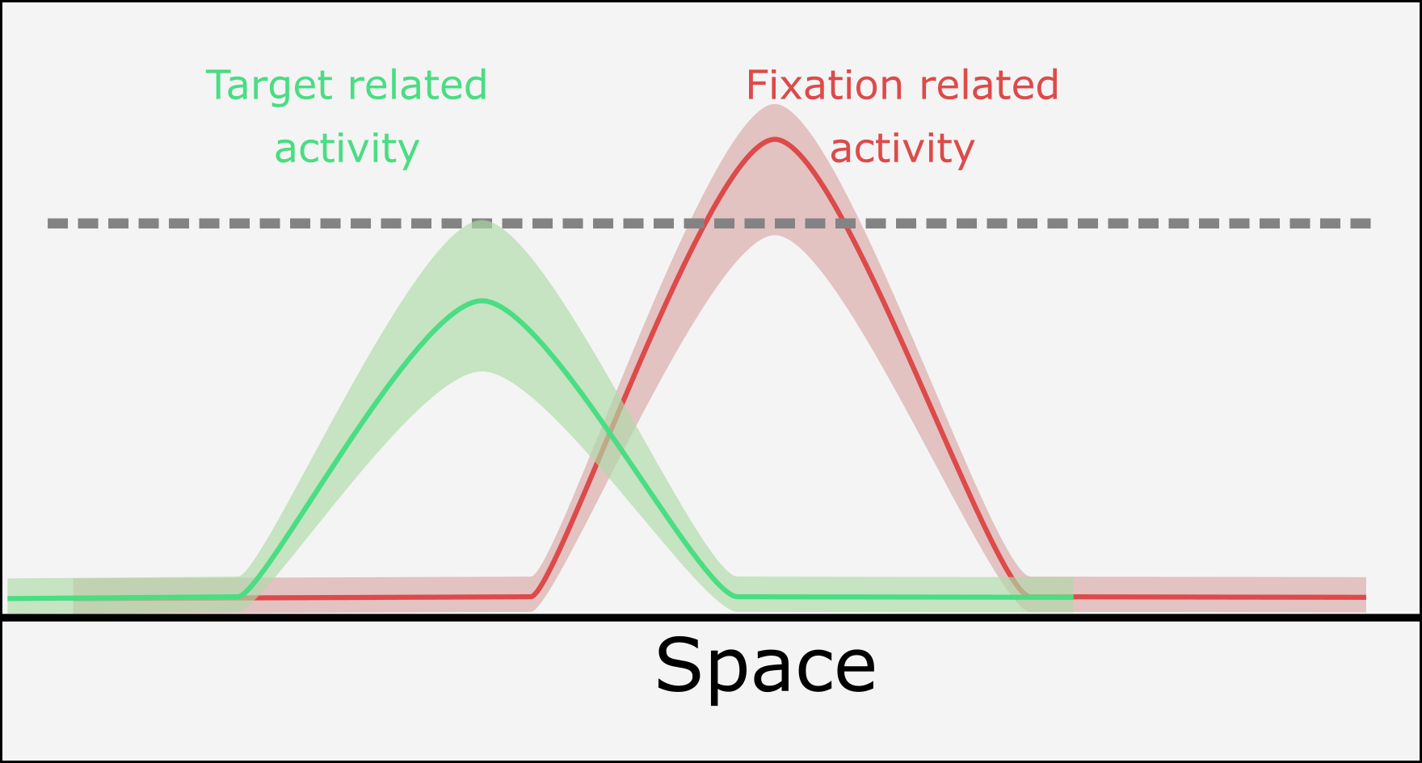
INTRODUCTION
DINASAUR and Annie’s experiment

Slide 5
INTRODUCTION
DINASAUR and Annie’s experiment

Slide 6
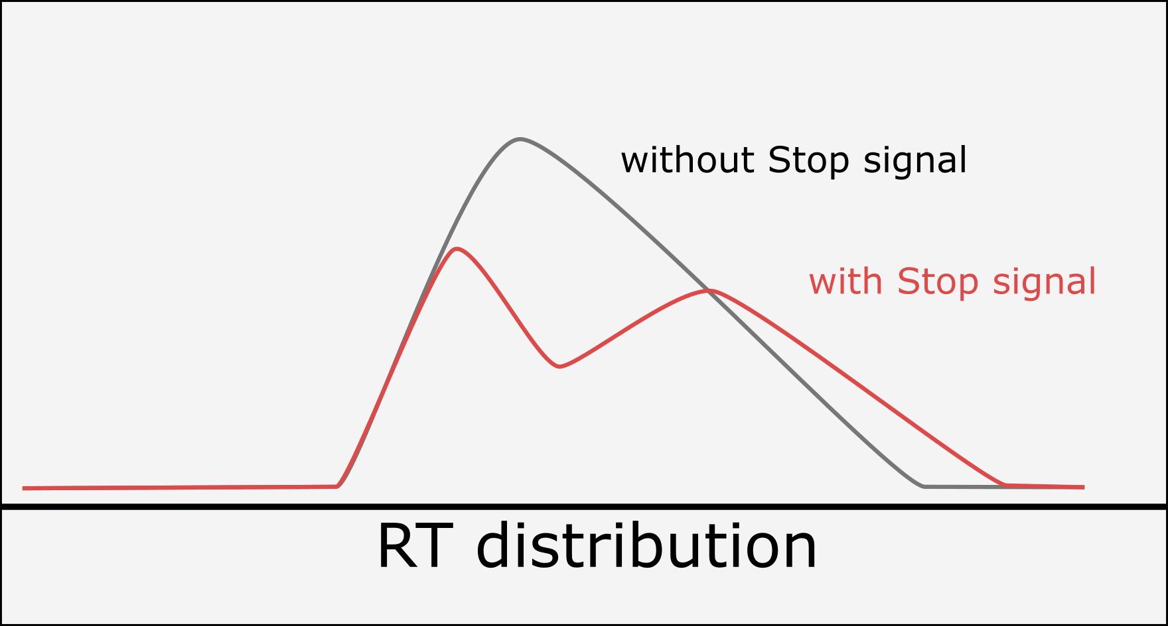
INTRODUCTION
DINASAUR and Annie’s experiment
time

Slide 7
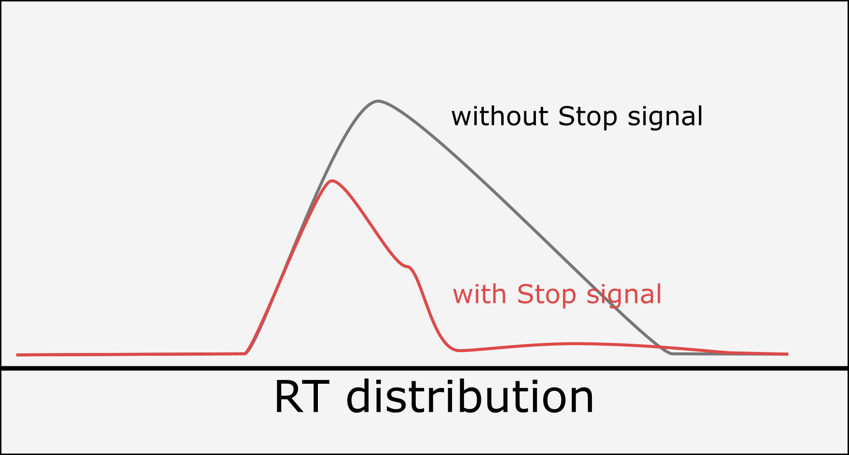
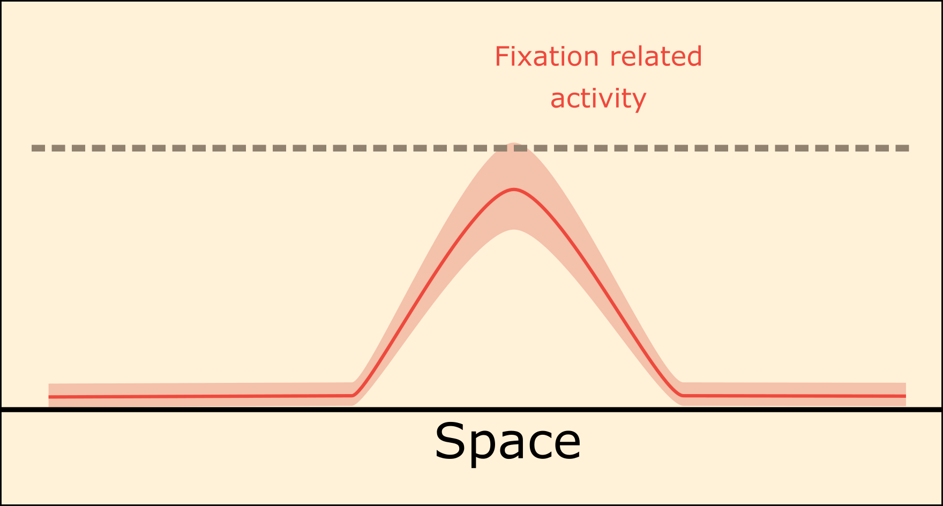
INTRODUCTION
DINASAUR and Annie’s experiment
TOP DOWN
time

Slide 8

INTRODUCTION
DINASAUR and Annie’s experiment
OK, that is good, but …
DINASAUR is made to:
trigger a saccade whenever the threshold in passed
trigger only one saccade per trial
P(Saccade) > 0
time

Slide 9

INTRODUCTION
DINASAUR and Annie’s experiment
Solution?

Slide 10
INTRODUCTION
In fact the fixational part of DINASAUR was already ignored in the original papers
Bompas and Sumner, 2011
Trappenberg, 2001
All the Reaction times (Target/Distractor) were taken only from the blue interval

Slide 11
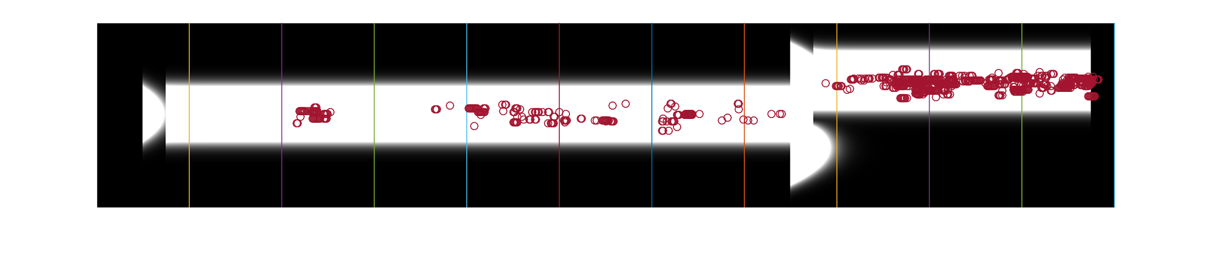
INTRODUCTION
The noise is so strong that it would have triggered micro-saccades on the fixation way before target presentation
One trial simulation of DINASAUR
Target
Fixation
Space (nodes)
Distractor
Time (ms)
Reported
in Bompas and Sumner, 2011
Actual first saccades
in Bompas and Sumner, 2011

Slide 12
INTRODUCTION
Is ignoring the fixation part when modelling saccade
generation a good solution?

Slide 13
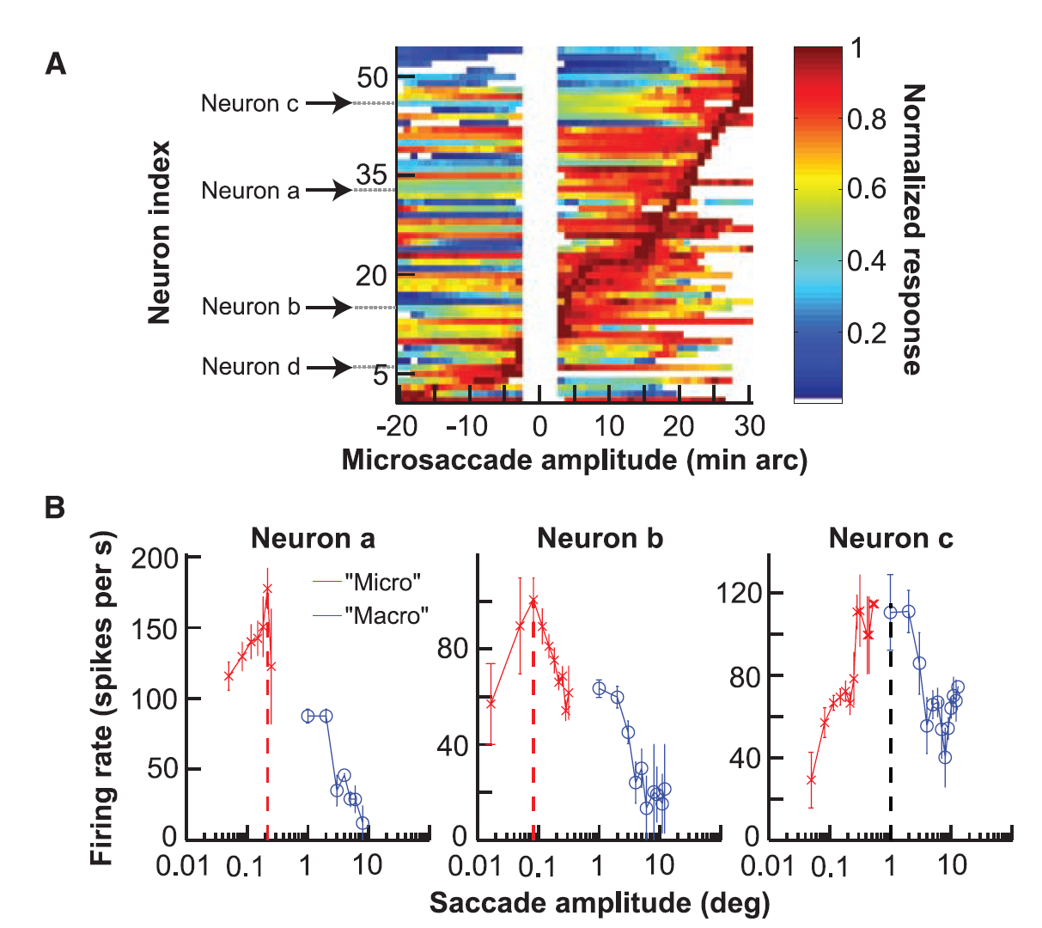
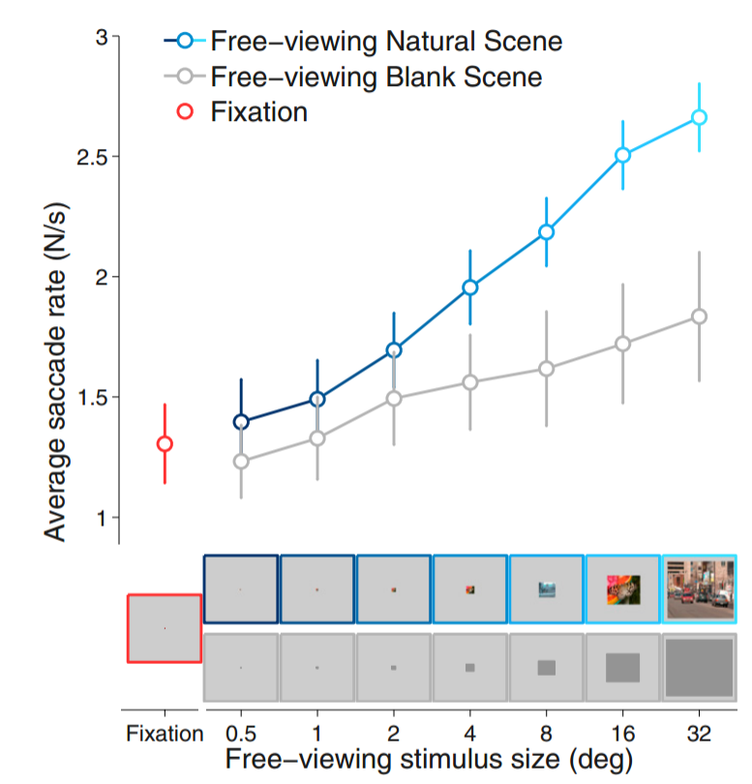
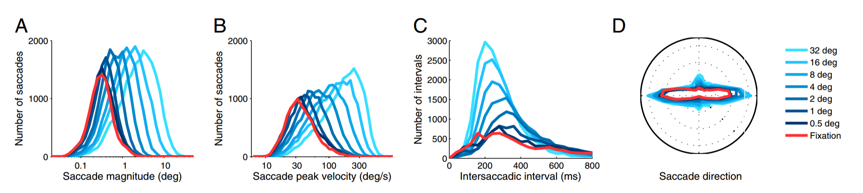
INTRODUCTION
Hafed et al. 2008-2016
Micro saccades are not different from Macro saccades
Both generated/controlled by the SC
Otero-Millan at al. 2008-2013
Micro saccades are not different from Macro saccades
Continuum from fixational movement to free viewing

Slide 14
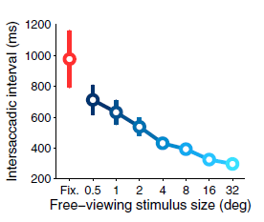
PROBLEMATIC
So why ignoring small saccades? In DINASAUR, small saccades were:
Not well distributed in time? (Too many)
Not well distributed in space? (centred on zero)
Messing up the trials (accounting for one saccade per trial)

Slide 15
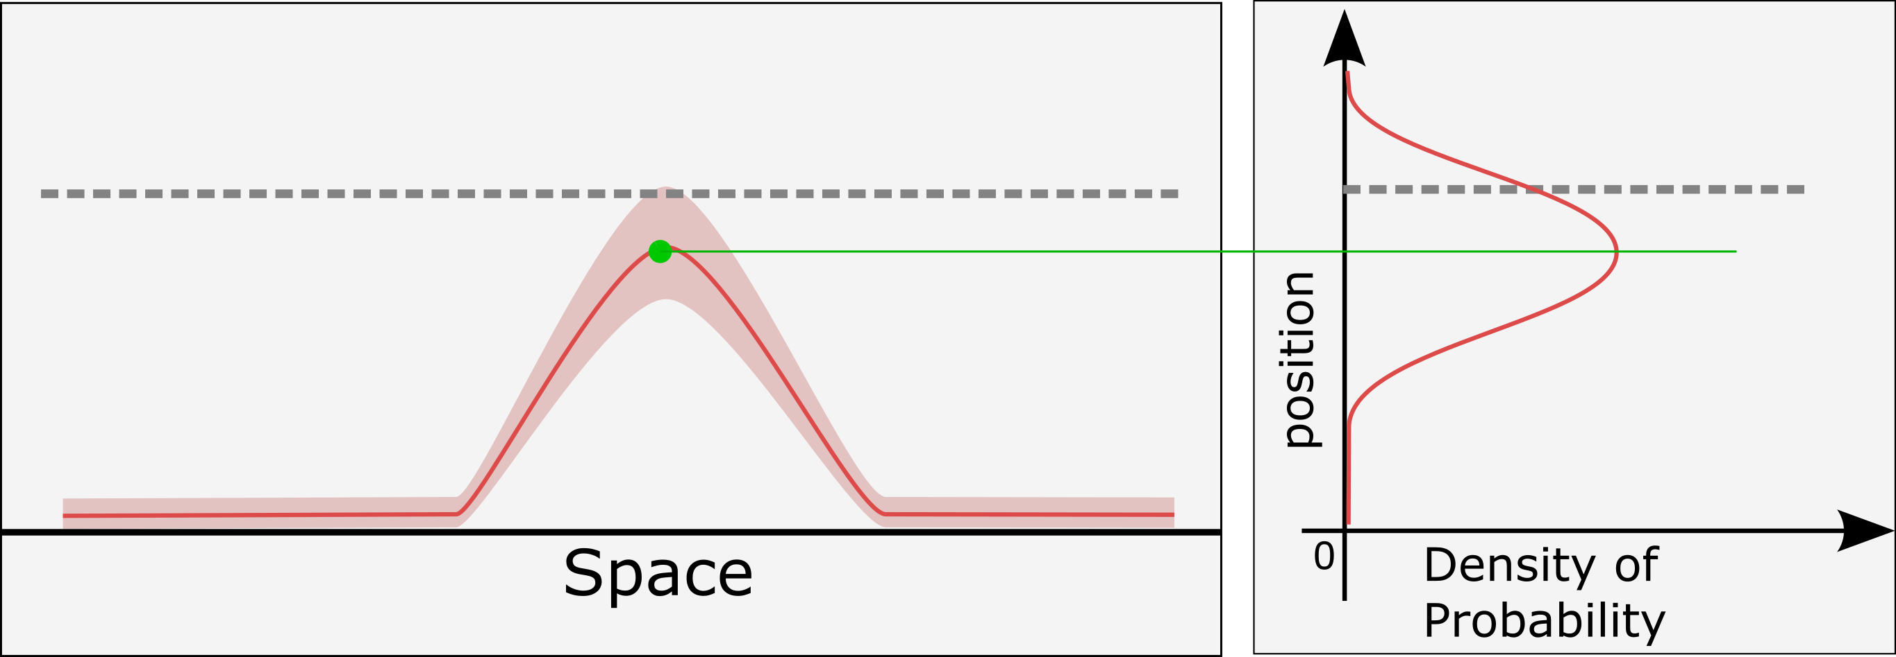
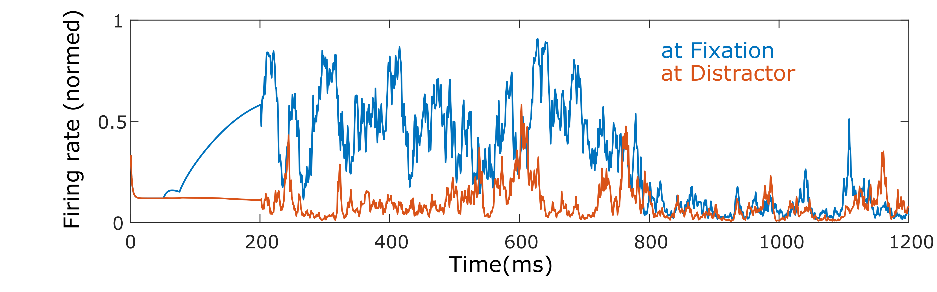
TEMPORAL DISTRIBUTION
Noise in DINASAUR
- Difficult to control of the probability to trigger a saccade
- Noise interacts with the mutual excitation/inhibition interactions

Slide 16
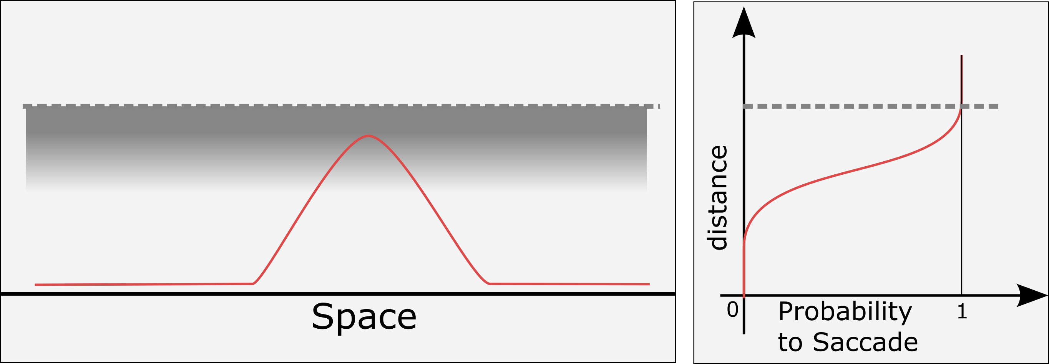
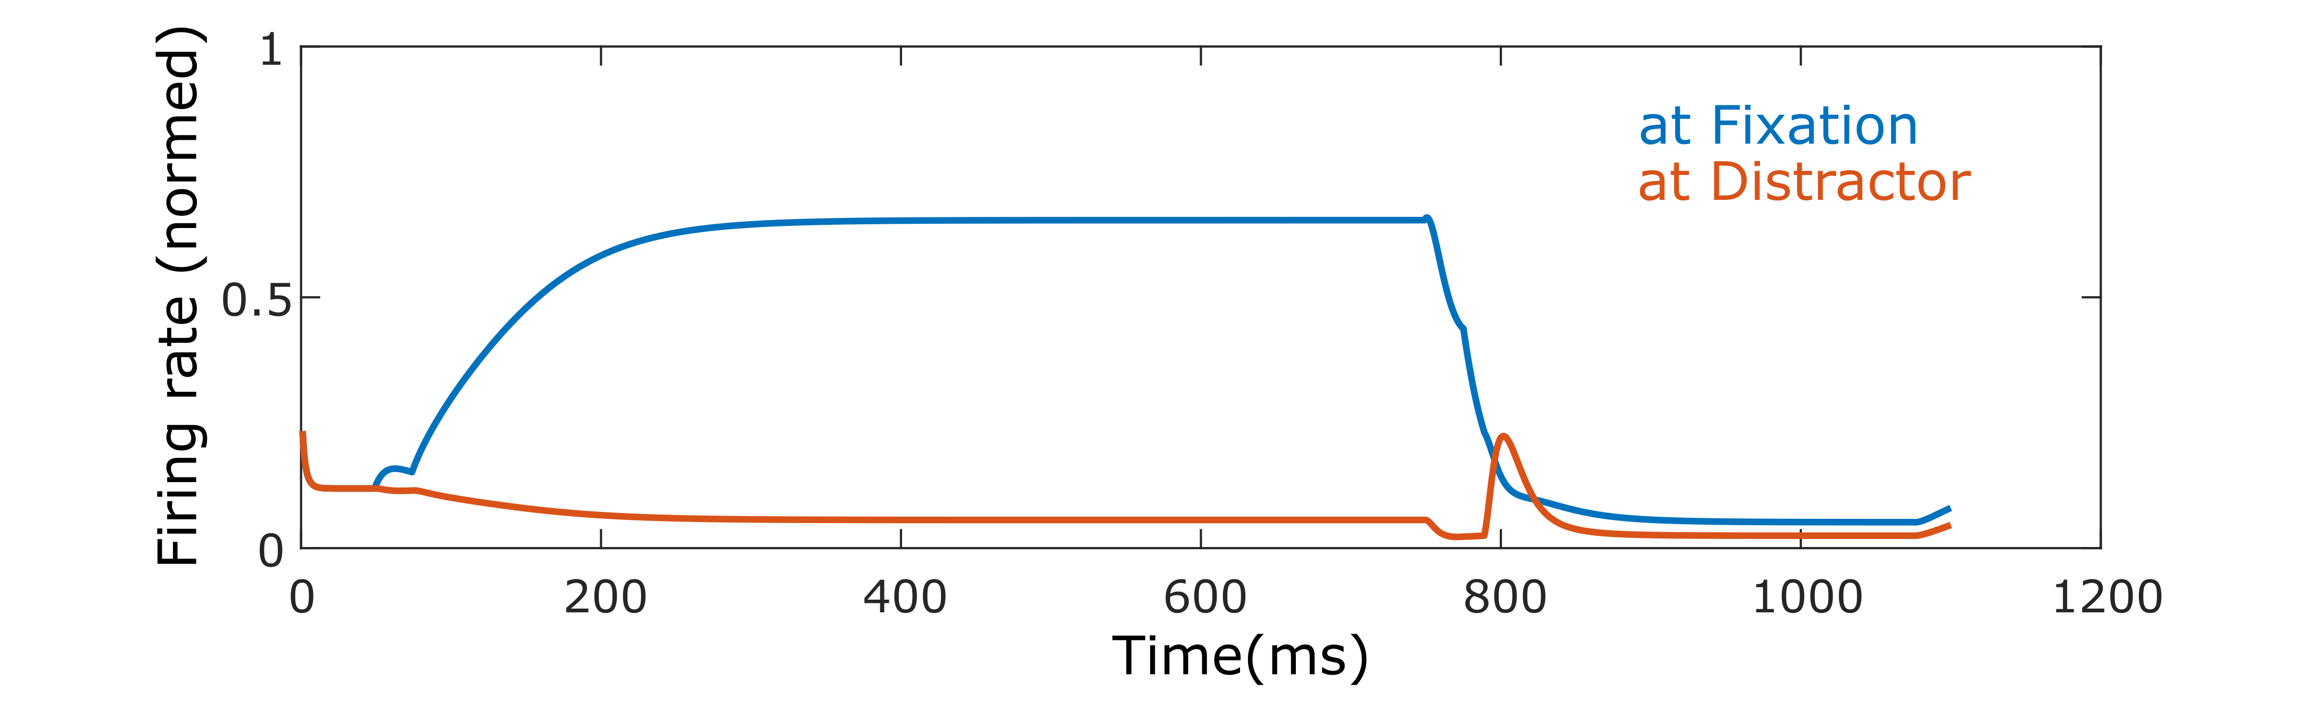
TEMPORAL DISTRIBUTION
Stochastic Threshold
- Used as a general model of noise for fitting neuron models
- Direct control of the probability to trigger a saccade
- Noise is independent from stimulus interactions
(note the small effect of Distractor)

Slide 17
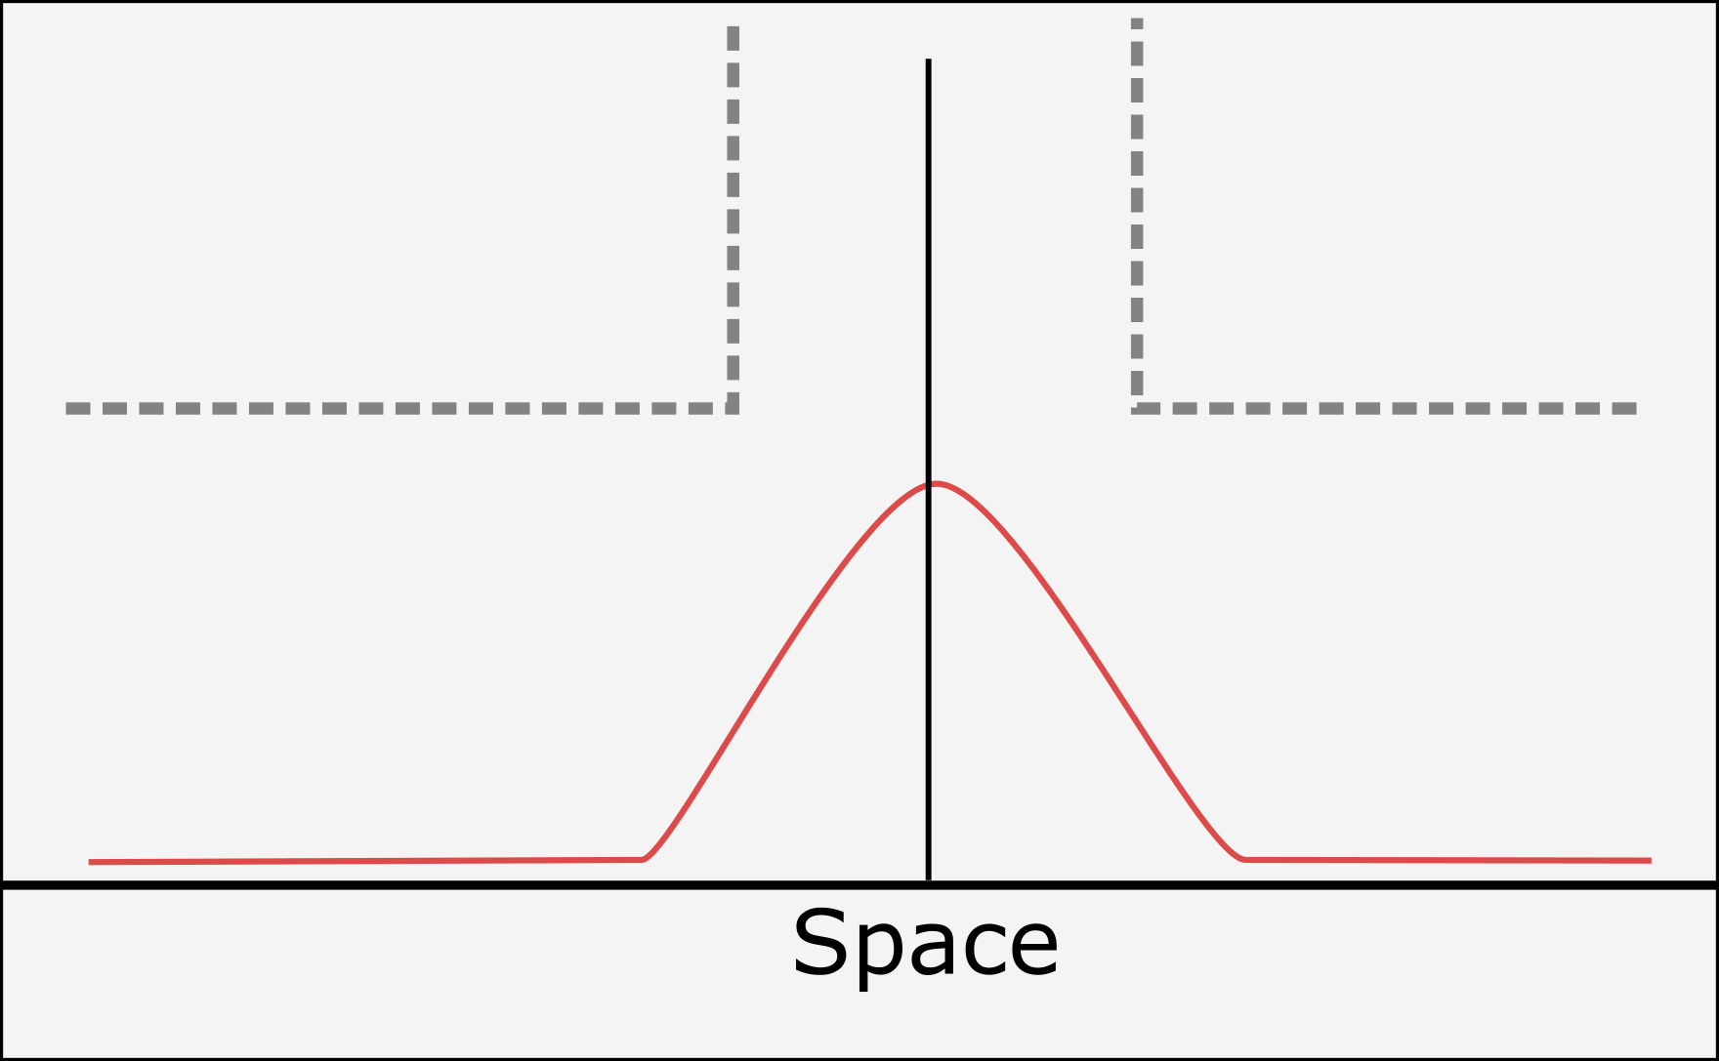
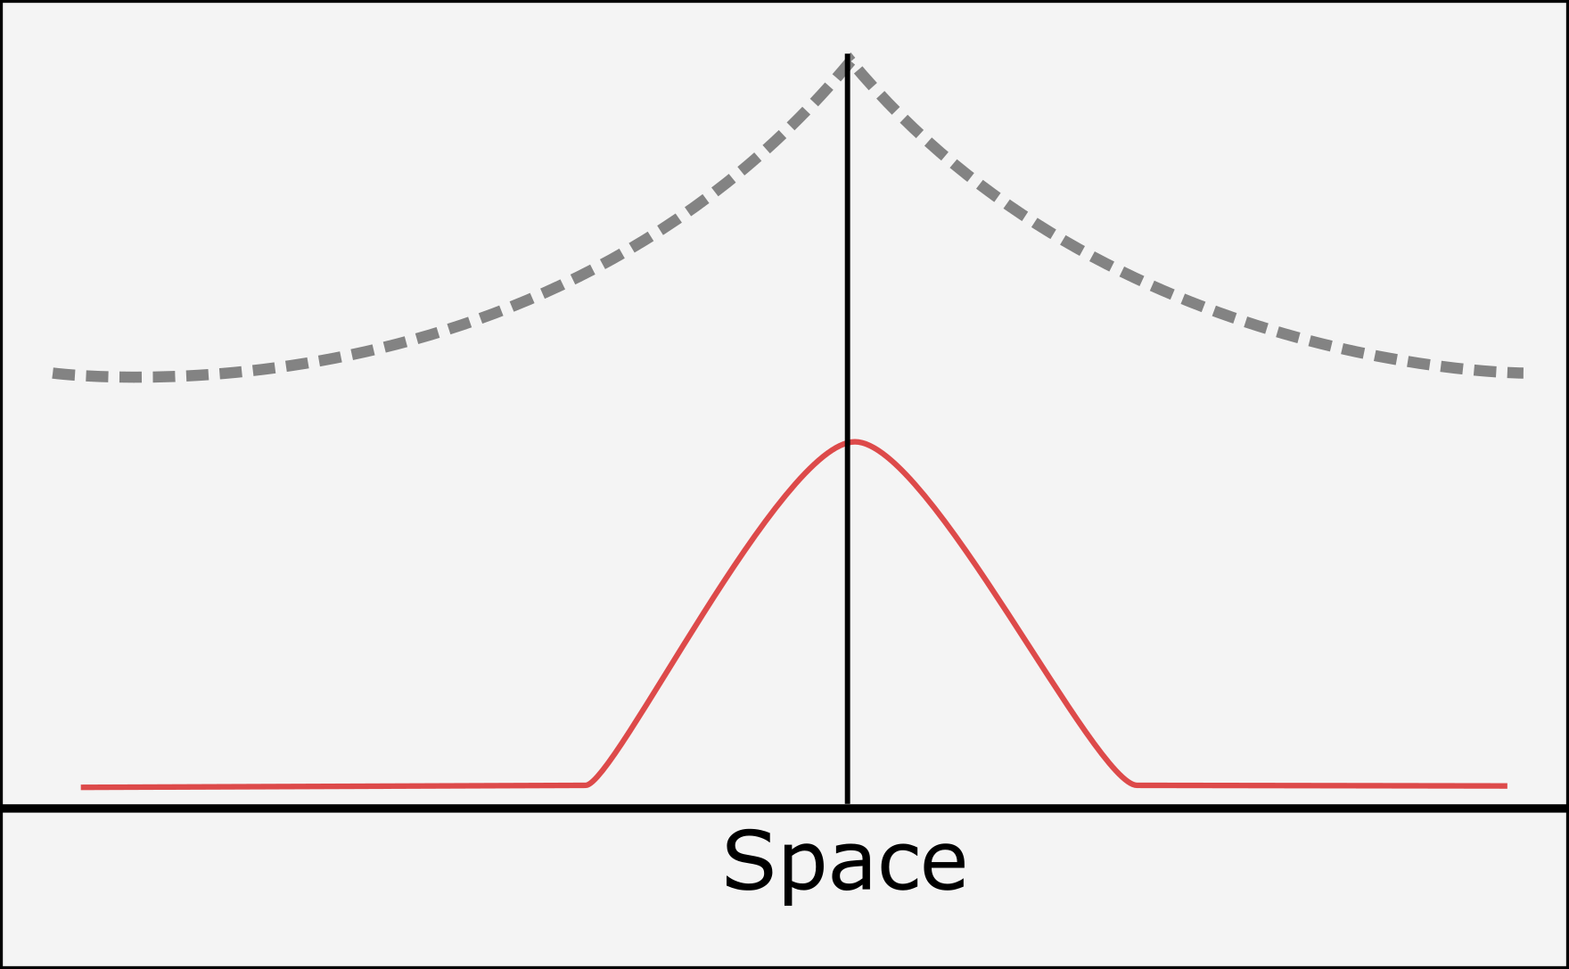
SPATIAL DISTRIBUTION
Alternatives to spatially homogenous threshold (i.e. flat threshold):
DINASAUR in Annie’s experiment
Exponential Threshold

Slide 18
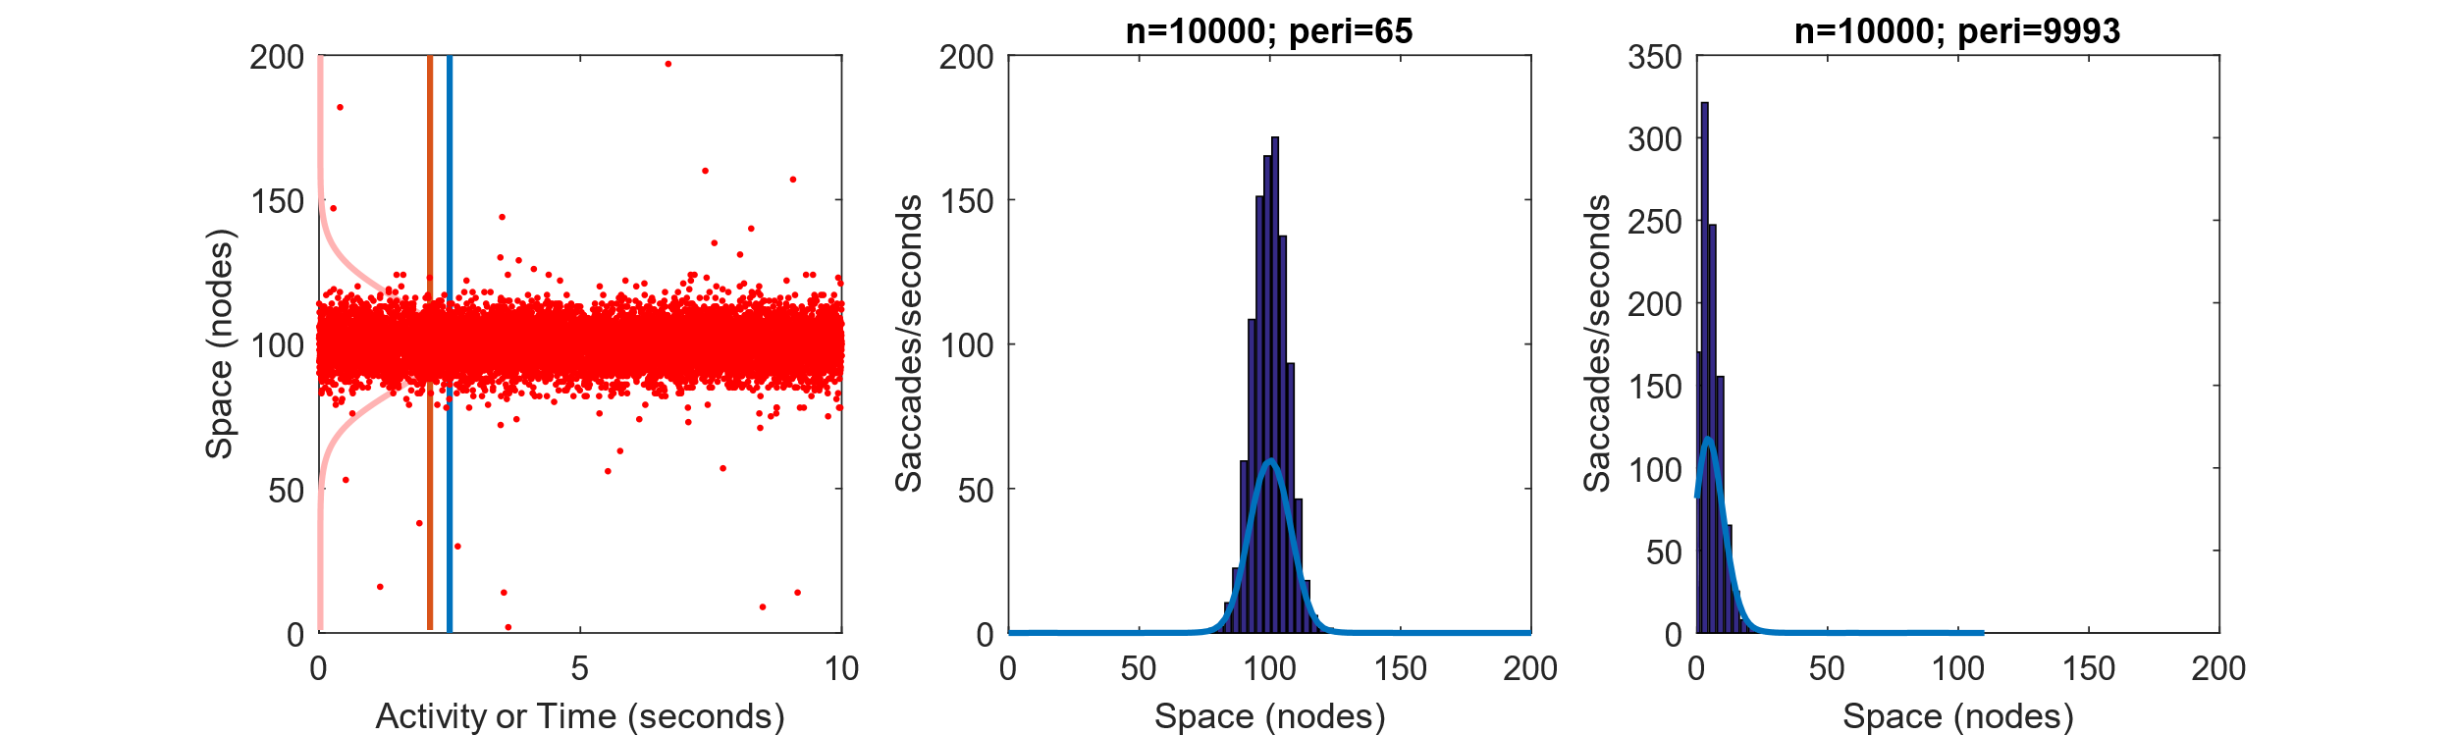
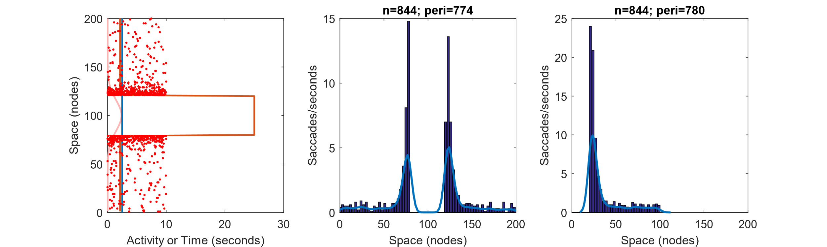
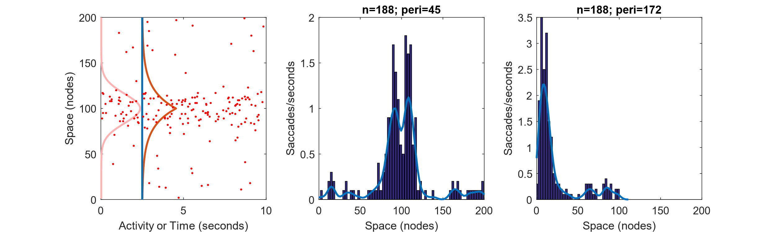
SPATIAL DISTRIBUTION
(Caution! We’re not using DINASAUR - come back to that later)
Reference from Otero-Millan et al.
Fixation stimulus
clipped to the fovea
(i.e. at node 100)
(the log space allows us to compared directly to the model space)
It seems that Otero-Millan results
Could be explained by a mix of step
and exponential functions

Slide 19

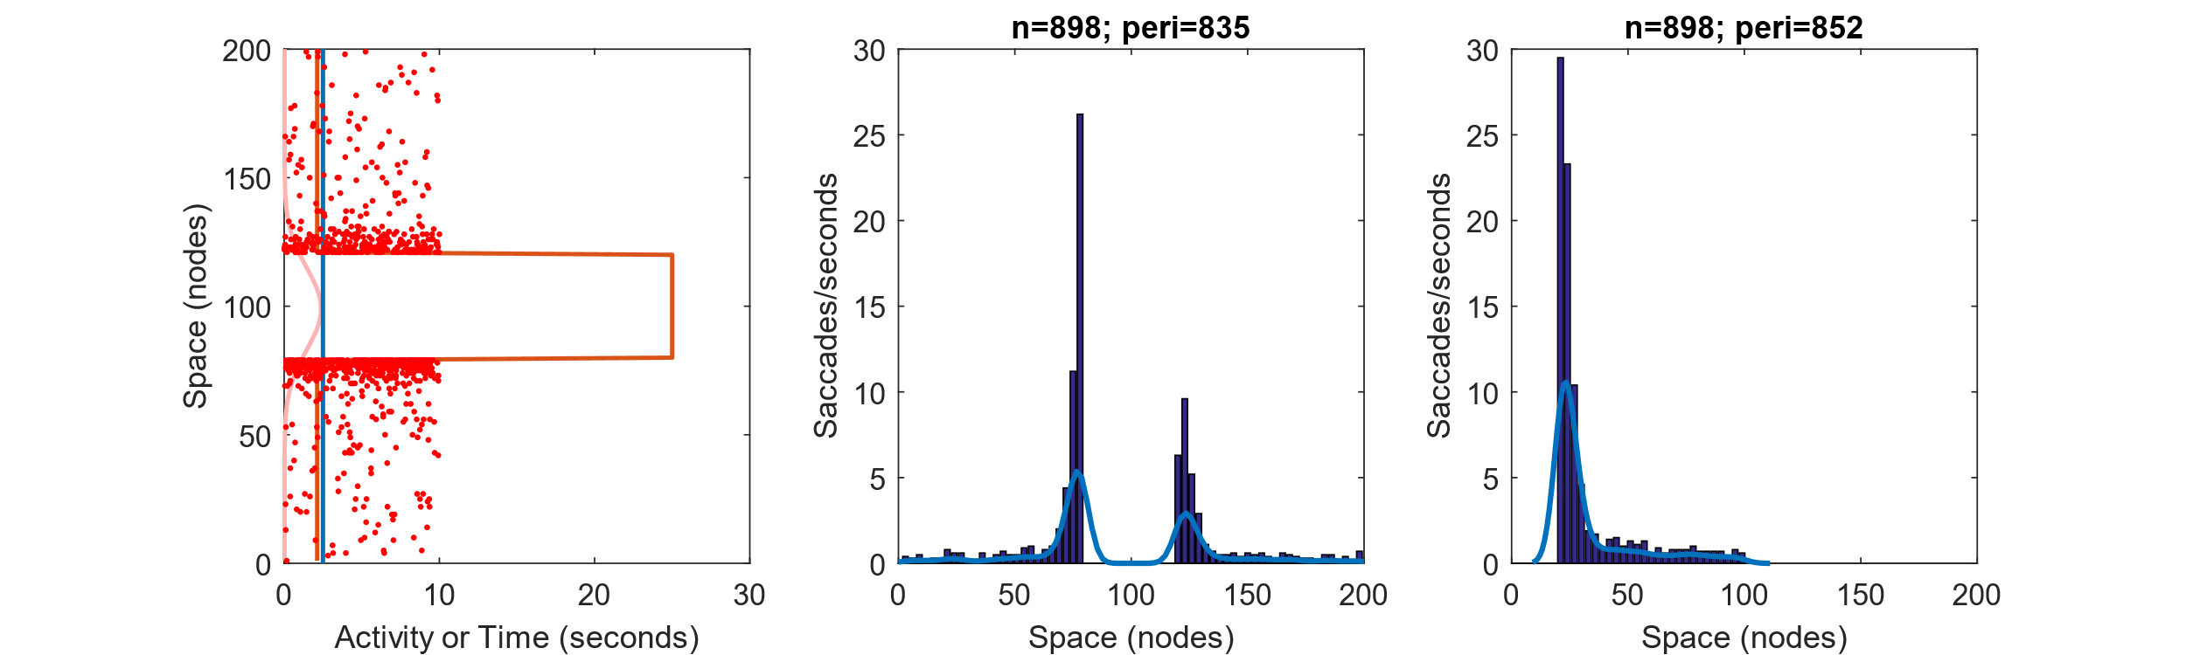
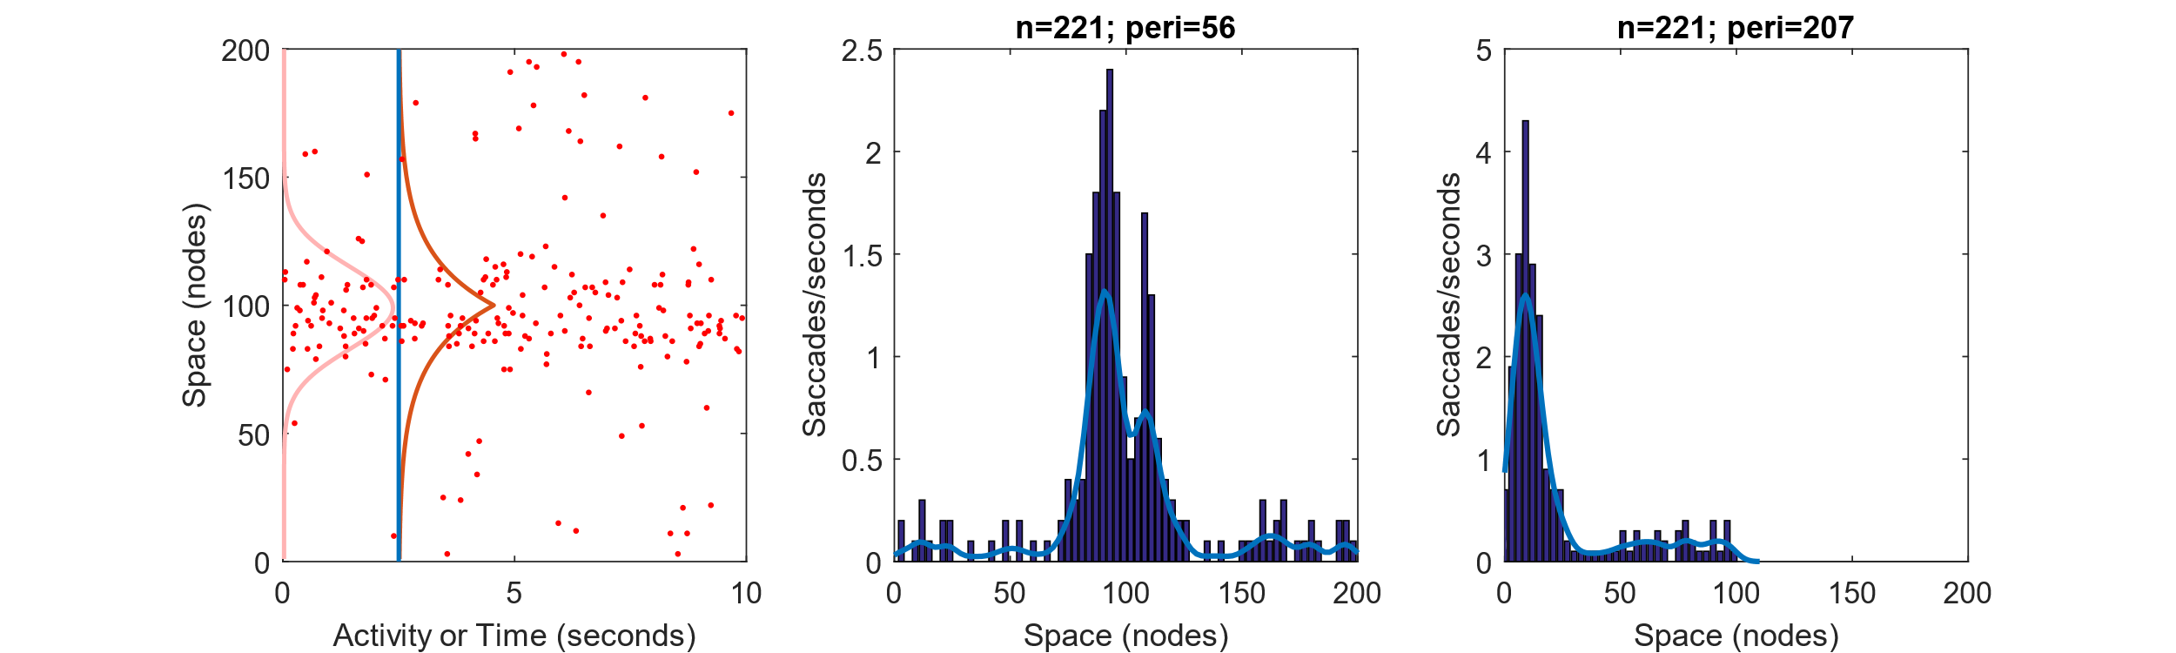
SPATIAL DISTRIBUTION
Reference from Otero-Millan et al.
Fixation stimulus
slightly shifted from the fovea
(i.e. node 99)
(the log space allows us to compared directly to the model space)
Step and Exponential functions give more advantage to corrective saccades

Slide 20
Unifying micro and macro-saccades
not well distributed in time
not well distributed in space
Stochastic Threshold
Exponential Threshold

